Slide 1
THE Cost(s) of PUBLISHING MONOGRAPHS
Nancy Maron, BlueSky to BluePrint
Library Publishing Forum 2016
May 19, 2016

Slide 2
blueskytoblueprint.com/
Strategic consulting, research and training
Focus on business models, marketing strategy and product development
Reports, case studies and tools freely available on website
Customized training and workshops for project teams

Slide 3
The monograph on the couch
Today…
difficult sales environment, leading to low revenues and modest circulation
pressure from federal mandates to make publicly funded research freely available
evidence from STEM journals that author-side payments can work
opportunity for greater impact?

Slide 4
could a supply-side model translate to books?
Several initiatives already in progress.
Growing interest in a system-wide plan to subsidize Open Access scholarly monographs:
Author pays?
Funder pays?
University pays?

Slide 5
FIRST…
What would the cost per book actually be?
Who would determine how the funding was distributed and how?
How might faculty respond to this? Administrators?
What implications might this have for libraries?

Slide 6
MELLON-FUNDED STUDY (2016)
A study of 20 presses, 20 titles each
Onsite visits to gather staff-level data
Data on all stages of the publishing process… including staff, direct and overheads.

Slide 7
The study’s innovations incLuded
Encouraging presses to isolate costs for monograph list
Developing a cost for STAFF TIME
Including time-spent, not just in publication year, but lifetime
Taking into account relative time spent on simple v complex titles
Weighting G+A and Departmental overhead, based on time spent on monographs
Defining notion of cost tiers – basic, full cost and full cost plus

Slide 8
COST TIERS…in more detail
Cost type | Category | Average cost per title |  | BASIC | FULL COST | FULL COST PLUS
Staff time | Acquisitions Activities | $5,891 | $15,565 | $23,391 | $26,022 | $28,637
 | Manuscript Editorial Activities | $2,250
 | Production Activities | $764
 | Design Activities | $2,561
 | Marketing Activities | $4,098
Staff OH | Staff Time, overhead | $4,694 | $4,694
Direct costs | Acquisitions | $400 | $3,132
 | Manuscript Editorial | $1,130
 | Production | $83
 | Design | $1,417
 | Marketing | $102
Press-Level Overhead | G+A and Departmental Overheads | $2,631 | $2,631
In-kind | Press & Department level | $1,523 | $2,614
 | Title-level | $1,091
Average Cost per title, University of Michigan Press, FY2014

Slide 9
COST TIERS…in more detail
Cost type | Category | Average cost per title |  | BASIC | FULL COST | FULL COST PLUS
Staff time | Acquisitions Activities | $5,891 | $15,565 | $23,391 | $26,022 | $28,637
 | Manuscript Editorial Activities | $2,250
 | Production Activities | $764
 | Design Activities | $2,561
 | Marketing Activities | $4,098
Staff OH | Staff Time, overhead | $4,694 | $4,694
Direct costs | Acquisitions | $400 | $3,132
 | Manuscript Editorial | $1,130
 | Production | $83
 | Design | $1,417
 | Marketing | $102
Press-Level Overhead | G+A and Departmental Overheads | $2,631 | $2,631
In-kind | Press & Department level | $1,523 | $2,614
 | Title-level | $1,091
Average Cost per title, University of Michigan Press, FY2014

Slide 10
COST TIERS…in more detail
Cost type | Category | Average cost per title |  | BASIC | FULL COST | FULL COST PLUS
Staff time | Acquisitions Activities | $5,891 | $15,565 | $23,391 | $26,022 | $28,637
 | Manuscript Editorial Activities | $2,250
 | Production Activities | $764
 | Design Activities | $2,561
 | Marketing Activities | $4,098
Staff OH | Staff Time, overhead | $4,694 | $4,694
Direct costs | Acquisitions | $400 | $3,132
 | Manuscript Editorial | $1,130
 | Production | $83
 | Design | $1,417
 | Marketing | $102
Press-Level Overhead | G+A and Departmental Overheads | $2,631 | $2,631
In-kind | Press & Department level | $1,523 | $2,614
 | Title-level | $1,091
Average Cost per title, University of Michigan Press, FY2014

Slide 11
Average costs per title

Slide 12
Acquisitions
Manuscript Editorial
Design
Production
Marketing
Sales, Distribution, Dissemination
Key Stages in the Publishing Process
Selection process
Conferences
Peer Review
Publication Board
MS Development
Author support
Copyediting
Proofreading
Project management
Permissions mgmt.
File pre-processing
Indexing
Copyright registration
Cataloguing
Author support
Display markup & composition
Interior Design
Illus. preparation
Suppl. materials prep
Cover design &
Image permissions
Author support
Digital file prep
Digital asset mgmt.
File conversion
File distribution
File preservation
Author support
Catalog preparation
Advertising
Publicity
Catalog and jacket copywriting
Website, emarketing
Title-specific emarketing
Social media
Discovery metadata
Review copy admin
Awards admin
Conferences, exhibits
Direct Mail (print/ Email)
Author support
Sales calls
Online distribution, Vendor relationships

Slide 13
findings
Acquisitions is a major expense, both due to time spent and level of staff in those roles
Even with outsourcing, many staff play a role in quality assurance
Each department cited not just technical aspects of complexity in driving cost, but degree of author support needed

Slide 14
WHAT DOES THIS MEAN FOR a pricing model?
Cost is not the same as price
Presses will want to use this data to guide their own process
Establishing pricing will bring in estimates of potential revenue and other subsidy as well

Slide 15
What to keep and what to change?
What presses loved…
and didn’t
Knowing range of costs
Seeing costs, particularly staff time, broken out by department and activity
Staff-level discussions about process, obstacles, and perceived value were very revealing
System of gathering data too complicated at the staff level for several reasons:
Staff found the questions difficult
Some more comfortable estimating than others
Difficult to think about monographs as as a separate category
Logistics: laptops not always on hand; not all staff use Excel

Slide 16
NEW P+L Tool…
Mellon-funded project to create a simple tool so that presses can determine cost per book for themselves
Provide written guidance for presses to host conversations with staff as part of the process
Offer clear, easy-to-digest outputs to help presses make use of this data, when considering their own operations and when expressing their costs to others.

Slide 17
GATHERING THE DATA
ORIGINAL STUDY
NOW
Lots of questions
Staff completed sheets, on paper, Excel, etc…
Output difficult to visually interpret
20 titles, strict definition of “monograph”
Fewer questions
Staff or Biz Mgr may complete
Results will be clearly displayed
10 or fewer titles; press can establish its own definition, based on the data they require

Slide 18
Two final outputs
DASHBOARD
COST STATEMENT
Synthesis of data captured at staff, dept, and press level
Snapshot of average costs
Visualizations of key measures
A per-title cost estimate
To use when seeking subsidy
Should be easy to read, transparent, and clear to those not necessarily in publishing

Slide 19
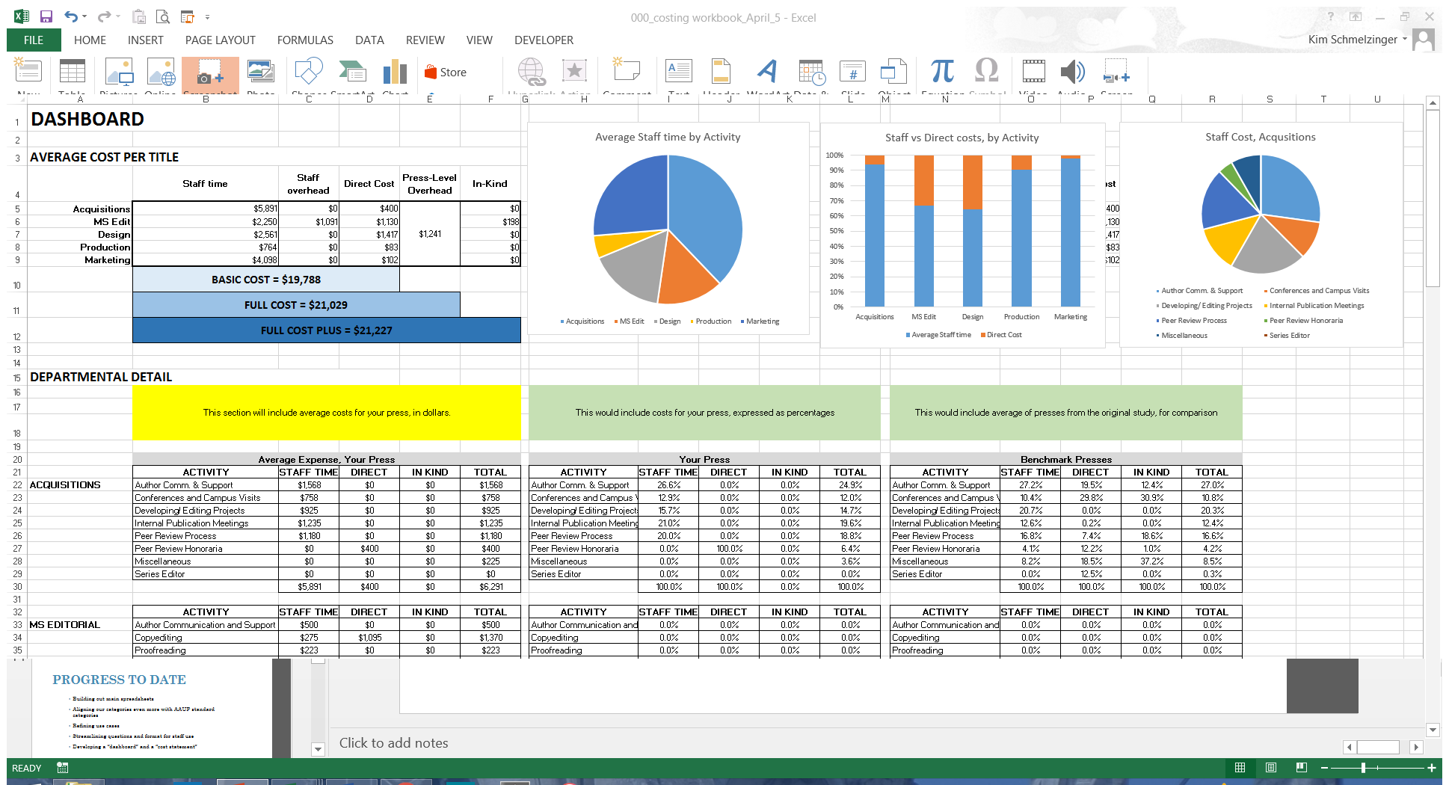

Slide 20
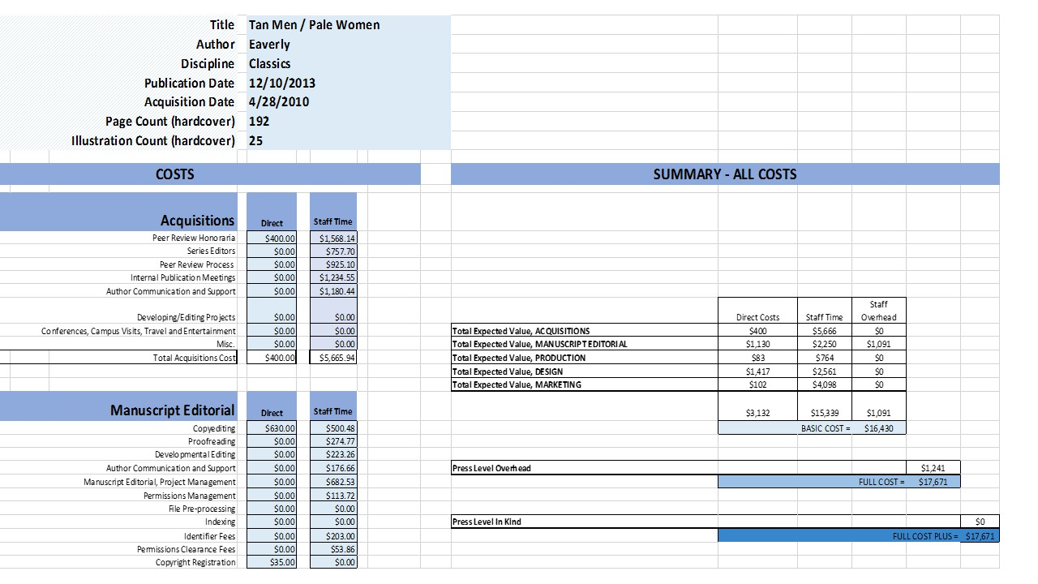

Slide 21
Implications for library publishers
Importance of transparency in terms of costs, in terms of activities
“OVERHEAD”
Is cost driven by the work…. Or by the institution and tradition?
In a new, digital-first press… what will costs look like?
How do (would) your costs compare?
Do you do all these activities now?
Could you do them for less?
Or do you need to start doing more things?

Slide 22
Next steps…
Finishing the ‘plumbing’!
Testing the tool – any takers?
Sharing publicly by Q3…

Slide 23
blueskytoblueprint.com/
Strategic consulting, research and training
Focus on business models, marketing strategy and product development
Reports, case studies and tools freely available on website
Customized training and workshops for project teams

Slide 24
BUSINESS MODEL BOOTCAMP AUGUST 8-10 -- chicago http://blueskytoblueprint.com/
August 8-10 @ Northwestern
3-day Intensive workshop
Create or refine the sustainability strategy of your innovative initiative
Identify and test assumptions concerning goals, audience, competition, costs, revenue, and other forms of non-financial support.
Limited to 8 teams of 2, from publishers, libraries, societies and academia.
Apply at blueskytoblueprint.com

