Slide 1
Amplifying Student Voices in Library Publishing through Experiential Learning &
High Impact Practices
Jane Nichols
Korey Jackson
2016 Library Publishing Forum
Denton TX
Notes:
Introductions
Good afternoon & thank you for joining us. My name is Jane Nichols and I am an Instruction & Emerging Technologies librarian @ Oregon State University; which basically means I provide instruction, primarily to OSU’s College of Liberal Arts and I work with emerging tech, such as our digital publishing program-one slice of our overall suite of publishing services. I’m joined by Korey who will introduce himself.
Today we wanted to talk about students and one form of experiential learning & high impact practices, internships, in the context of library publishing services. As you likely know publishers both at university and elsewhere rely on this form of student labor whether for credit, paid or even unpaid. We wanted to discuss students as interns in our broader community to consider whether our practices align with experiential learning and high impact practices and how our programs might amplify student voices. As we proceed today we will intersperse time for structured discussion and activities so we can learn from each other.
2:45-4pm Thursday May 19, 2016
http://www.sciencedirect.com/science/article/pii/S0099133316300180
George Kuh’s 2008 report High-Impact Educational Practices: What They Are, Who Has Access to Them, and Why They Matter, demonstrated the link between high impact practices, experiential learning and student success. Since then, libraries, as part of their parent institutions, have joined the discussion on ways to offer experiential learning opportunities. One long-standing practice is through student internships. Library publishing programs have readily adopted student interns to advance their work; however, such internships are often ad hoc, focusing less on student learning outcomes and more on production and project completion. With Kuh’s call to foreground high impact practices and experiential learning to advance student success, it is worthwhile to revisit library publishing internships and develop programmatic models.
OSU Libraries Publishing began offering internships as one way to firmly link the program to the library and university teaching mission. Along the way, questions about implementation surfaced. We will consider what best practices are emerging and examine current internship models within library publishing, digital scholarship centers, and academic libraries more broadly. We will also explore what counts as a successful internship (and from whose perspective) and look at some effective ways to evaluate and assess students’ experiences. By focusing on student impact, we aim to broaden the discussion around creating a successful library publishing program. Join us to discuss how library publishing programs can create intentional, meaningful internships.
What are some examples of successful lib publishing outfits that utilize student interns?
Why did we implement this program?
Internships are considered a “high impact practice” by the American Association of Universities and Colleges for numerous reasons including the opportunity for experiential learning, engagement with faculty, and (working with) researching as a group with their peers.
Citations
Kuh, George D. Excerpt from High-Impact Educational Practices: What They Are, Who Has Access to Them, and Why They Matter. Association of American Colleges and Universities, 2008.
O’Neill, Nancy. "Internships as a high-impact practice: Some reflections on quality." Peer Review 12.4 (2010): 4-8. https://www.aacu.org/publications-research/periodicals/internships-high-impact-practice-some-reflections-quality
York, Amy, Christy Groves, and William Black. "Enriching the academic experience: The library and experiential learning." Collaborative Librarianship 2.4 (2010): 193-203. http://collaborativelibrarianship.org/index.php/jocl/article/viewArticle/92
https://www.aacu.org/publications-research/periodicals/new-research-internships-and-experiential-learning-programs

Slide 2
Does your library publishing program offer internships?
Paid
For credit
Volunteer
Don’t offer
Notes:
We also wanted to get a sense of how many of us currently offer internships and knowing that for many of us, funding is tight, so no judgement about what we can offer.
I will say that our library publishing program is a couple years old and we just started offering 2 internships both paid and as we discussed these positions we talked about some of the issues we’ll bring up today; which made us think it would be worth a broader discussion. Maybe we’re not alone...

Slide 3
Best job….Worst job: what made it the best? Worst?
Notes:
Korey
Think about jobs you held as a student. What made your best job “the best”? Your worst job? List characteristics here. We will revisit some of these concepts later in our presentation. Your experiences may not be too far from what current students experience & Jane’s going to talk a bit about this.

Slide 4
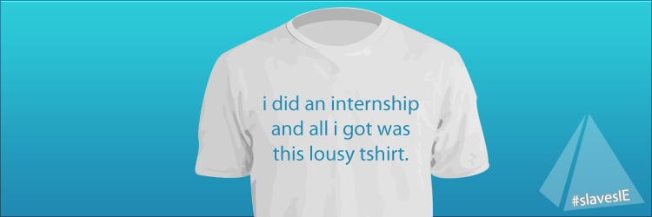
Sean MacEntee
Notes:
At first glance it appears that both interns and publishers benefit from this long-standing practice: the intern gets valuable experience and possible job prospects and the publisher has crucial work completed for little to no cost and, should a job match occur, a vetted, known employee requiring little to no on-boarding. However as recent calls have pointed out, the practice of offering internships or being an intern is not equal across the board, giving rise for us to collectively consider how we implement this practice. For example some years ago this twitter hashtag caused a bit of a kerfluffle as the author of the hashtag #slaves.ie, called for interns to share their worst, or at least unfair, internship stories. Note: the tag isn’t necessarily from Sean MacEntee, he featured this image in an article about the hashtag. Ultimately, in that article he articulated the issue as free vs. paid internships; while recognizing & applauding interns’ ability to get hands on work experience. For those wondering; .ie=country code for Ireland. I’m not sure I feel comfortable using the word slave...but i think it signals the amount of frustration interns feel. Fast forward to just a few days ago when Washington Post writer Danielle Douglas-Gabriel brought to light the unfairness students feel when having to pay tuition for credit bearing internships where the internship occurs at an organization outside of the university. She focused on Seton Hall students Katie Wolchko and Joshua Siegel, who started a petition at Seton to change this practice. If changed, this could benefit students for whom the tuition cost is a barrier.
https://www.flickr.com/photos/smemon/6014438906/sizes/l
https://seanmacentee.com/unpaid-internships-slavery-or-opportunity/

Slide 5
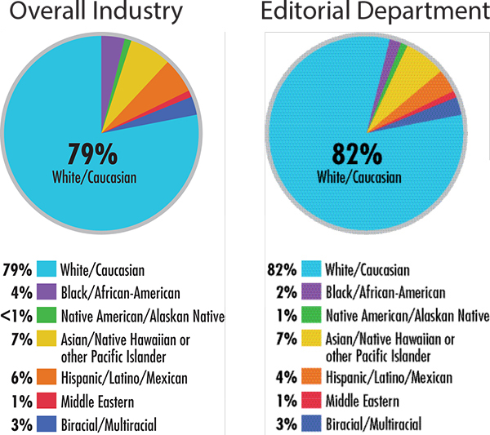
Racial composition of book publishers, based on data from the Diversity Baseline Survey.
Notes:
Another concern for us to consider as we offer internships is whether we are expanding the pipeline of who is able to take on an internship; particularly for those that are unpaid as this blocks out many folks. As was underscored in yesterday’s session with Charlotte Roh, Emily Drabinski and Harrison Inefuku, while the publishing industry, is aware of its lack of diversity, if we truly do seek a broader range of thought at the table; going forward more change is needed. Yesterday, we learned of AAUP’s and others’ efforts to effect such change. I wanted to highlight the organization We Need Diverse Books (WNDB) which offers grants to support interns from diverse backgrounds. They seek to support those who might not otherwise be able to accept an internships by offering grants to supplement paid internships at participating publishers. At the same time, a recent Publisher’s Weekly article cited unpaid internships as one reason for why publishing is still predominantly white. In preparing for today, I came across 2 other studies that highlight the class disparities as issues for us to consider. In her dissertation, Adry Clark found that “there is class disparity in the access and benefit from internship” and a report from the organization Intern Bridge found that students with low-incomes or from families with low-incomes also face barriers to accepting unpaid internships due to the associated costs. Keeping these recent issues in mind, let’s turn to high impact practices which have helped us be more intentional in our thinking about what we hope for our interns.
Publisher’s Weekly “Why Publishing Is So White: A deep dive into hiring practices across the industry shows that publishers care about diversity, but many haven’t taken effective steps to bring about lasting change” by Rachel Deahl, with reporting from Anisse Gross, Claire Kirch, Diane Patrick, and Judith Rosen.
Mar 11, 2016. http://www.publishersweekly.com/pw/by-topic/industry-news/publisher-news/article/69653-why-publishing-is-so-white.html
Clark, Adry S. The Experience of First Generation College Students who Cross Class Boundaries in Internship. Diss. Oregon State University, 2015.
Gardner, Phil. The debate over unpaid college internships. Intern Bridge, 2011.

Slide 6
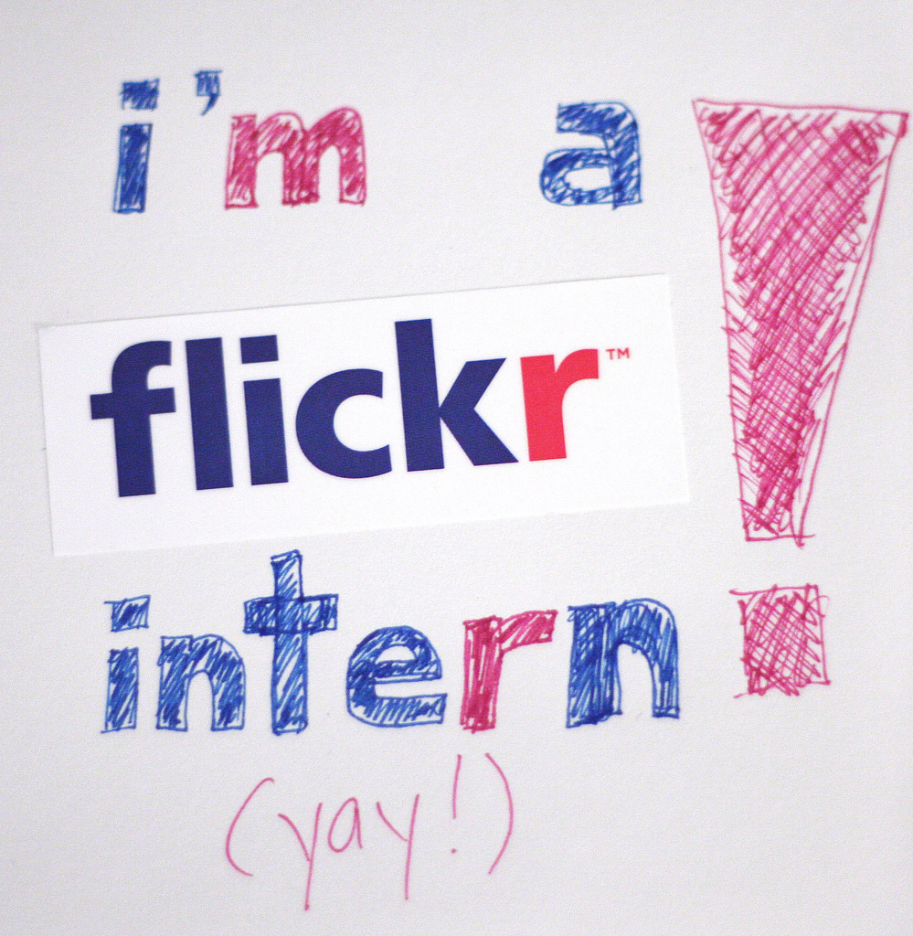
HIPs - Quality
•Time and effort devoted to purposeful work
•Meaningful and positive relationship (peer or mentor)
•Reflect on their growth (career, values, interests)
•Apply knowledge to new situations (such as outside the internship)
•Experience working with people who come from various backgrounds
•Receive rich feedback about their performance
foreverdigital
Notes:
I would guess that many of us are familiar with George Kuh’s work citing internships as one of many high impact practices. Building on this, Nancy O’Neill reflects on several ideas for us to think about as we design or co-design an internship experience. In lieu of simply thinking about the work that we want completed; there are several other aspects such as whether and how the work meshes with the student’s goals; how we plan to provide feedback; whether we are going to assist the student in transferring what they learn with us to other areas of their life; to thinking about whether the intern has an opportunity to connect with a range of people. Using these ideas to frame an internship we hope our interns will feel like
O’Neill, Nancy. "Internships as a high-impact practice: Some reflections on quality." Peer Review 12.4 (2010): 4-8.
https://www.flickr.com/photos/foreverdigital/2491201910/sizes/l

Slide 7
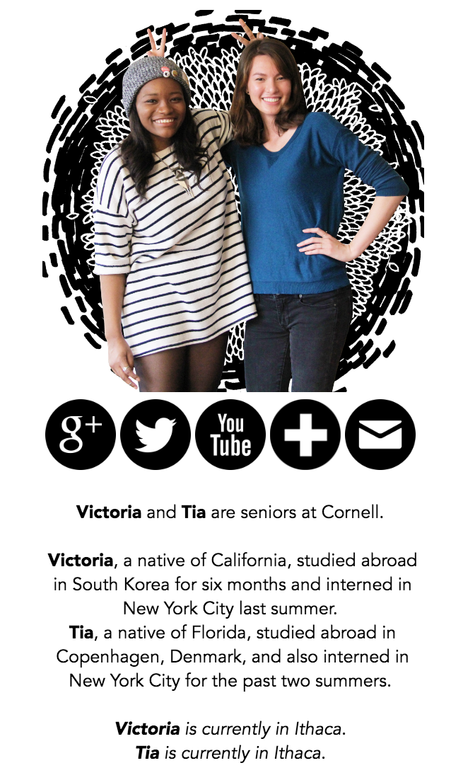
“Anyway: Being an intern in publishing is amazing. It means you're on the front lines of the publishing industry and you're seeing every part of it work. You're mailing out royalty checks, and writing up contracts, and directing authors to agents and reviewing their work. It is by far the most fun job I've ever had.”
http://duodiaries.blogspot.com/2015/07/whats-it-like-to-intern-in-publishing.html
Notes:
these students. Who wouldn’t want their interns to come away feeling like Tia a co-author of The DuoDiaries about her experience. Where she learned a lot, was on the front lines and had fun. To spur our thoughts about some practical ways we might employ these ideas, Korey is going to share some examples we might learn from.

Slide 8
Guiding Lights
Notes:
Martin Halpert, Katherine Skinner, Sarah Melton, Alan Pike, Brian Croxall, Miriam Posner and others
Tiered strategy not only provides internal motivation for advancement, also a way of enabling students to apply knowledge to new situations...in this case situations created by the program itself

Slide 9
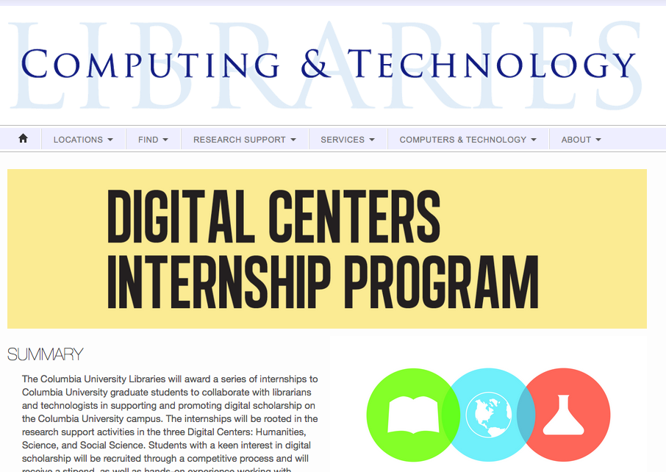
Notes:
Blogging out about their experiences helps students reflect on growth, changes in skillsets, values, etc. … and is a possible venue for feedback. Not only this but it also helps showcase the value of the program to other folks in the library and campus at large.

Slide 10
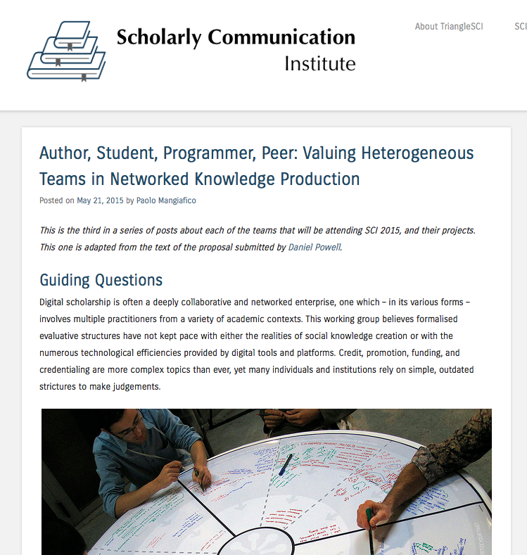
Notes:
Aaron Mauro at Penn State Behrend created an undergraduate research fellowship program giving students opportunity to create self-led DH projects.
Students were involved at SCI in meta conversations around internships, evaluation, and assessment

Slide 11
Reflection: your intentional internship?
What needs to be in place to develop an internship program?
After today’s discussion, what revisions would you hope to make to your internship program?
Notes:
How it helps people gain access to publishing or not
Individual

Slide 12
Considerations for Developing or Revising an Internship Program
Your time
Who is eligible for the internship? Who is in/excluded?
Assessment/Grading
Self directed
Learning curve
What expertise does the student bring or will they gain? (project management, programming, outreach, promotion))
Partners for project completion
Funding for wages, stipends, etc.
Your ideas???
Notes:
We had come up with these as key questions to discuss while developing our program. One thing I learned in the process is about the concern regarding internships for credit. While i was the one who offered to facilitate the library being able to offer credit for internships, I now have work to do when I get back to educate my colleagues about the barrier of having to pay tuition for the internship. In digital publishing we’re really fortunate to have an endowment that we can draw on to support students.
The last point about internships, I wanted to bring up is assessment.

Slide 13
Assessment
Ongoing: pre-, mid-, post-
Student driven| Supervisee |Organization’s needs
Formative
help students identify their strengths and weaknesses and target areas that need work
help faculty recognize where students are struggling and address problems immediately
Summative
evaluate student learning at the end of an instructional unit by comparing it against some standard or benchmark
Example Form https://goo.gl/kGUKeK
Notes:
Taking a cue from our archives & special collections, who conduct ongoing assessment we asked our intern to complete a midterm assessment that asked about challenges, what he learned, about the feedback given thus far, and what he found most rewarding. Going forward, it would be great to talk with our interns about other ways they’d like to have their internship assessed to build in a student driven component.
We were heartened to learn that our first intern is having a positive experience and that he anticipates transferring knowledge learned to his future career and that feedback given has been helpful in scoping his work and shaping his focus.
With that, we thank you for your attention and participation. I think we have time for questions.

Slide 14
