Slide 1
Getting Titles into Link Resolvers
Wendy C Robertson (@wendycr_)
Library Publishing Forum, 18 May 2016, Denton, Texas

Slide 2
Introduction
Who am I?

Slide 3
Link Resolver 101

Slide 4
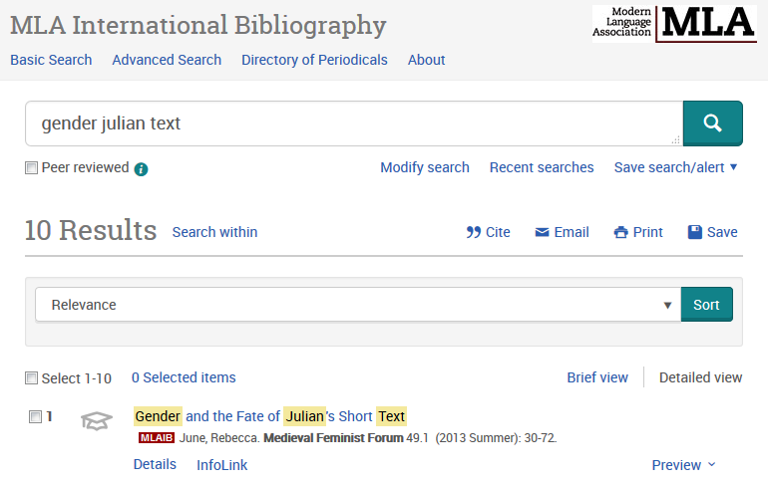
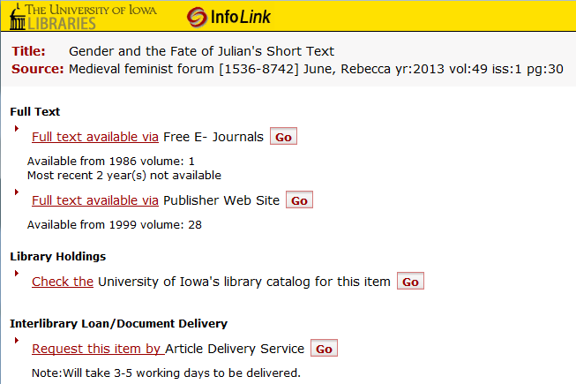
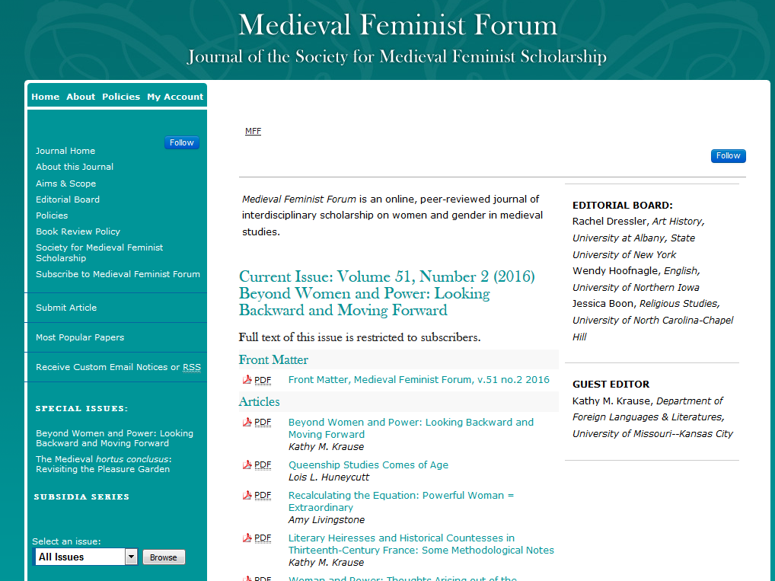
1. Free title in A&I database appears as citation only content
3. Clicking either full text link allows reader to get to our journal
2. Clicking our link resolver text allows reader to see options
4. Unfortunately the link goes to the journal home page and not the article or even the issue. The reader must browse “all issues”

Slide 5
Why bother?

Slide 6
Open access content should be included in link resolvers
“As users interact with library technology (such as link resolvers and resource discovery services), they are presented with all of the content that their home institution licenses on their behalf. For the library and their users it therefore makes sense that they can link to all the content delivered by a publisher together—both free and fee-based.”
Knowledge Bases and Related Tools (KBART) recommended Practice, NISO RP-9-2014, p.9

Slide 7
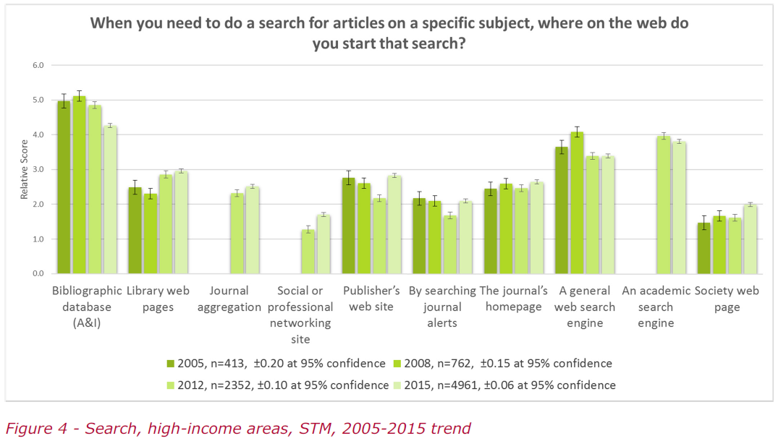
STM Disciplines
How Readers Discover Content in Scholarly Publications, By Tracy Gardner and Simon Inger. Renew Training, March 2016. p.11 http://sic.pub/discover, licensed under a Creative Commons Attribution-NonCommercial 4.0 International License
A&I use high; increasing use of library web pages.
Social networking sites include Mendeley, ResearchGate, and academia.edu. Google Scholar is an example of an “Academic search engine”

Slide 8
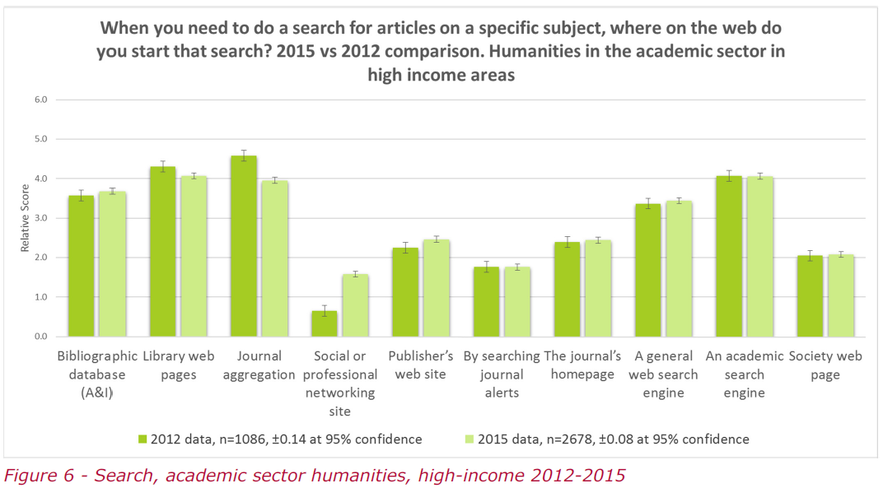
Humanities Disciplines
How Readers Discover Content in Scholarly Publications, By Tracy Gardner and Simon Inger. Renew Training, March 2016. p.11 http://sic.pub/discover, licensed under a Creative Commons Attribution-NonCommercial 4.0 International License
A&I indexes not used as heavily, but still a lot. Library web pages receive more use.

Slide 9
MARC Records
Libraries may rely on their link resolver to supply MARC records for all open access journals.

Slide 10
Google Analytics

Slide 11
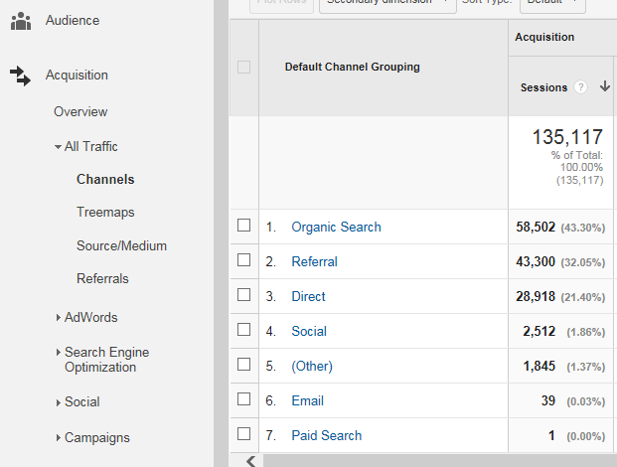
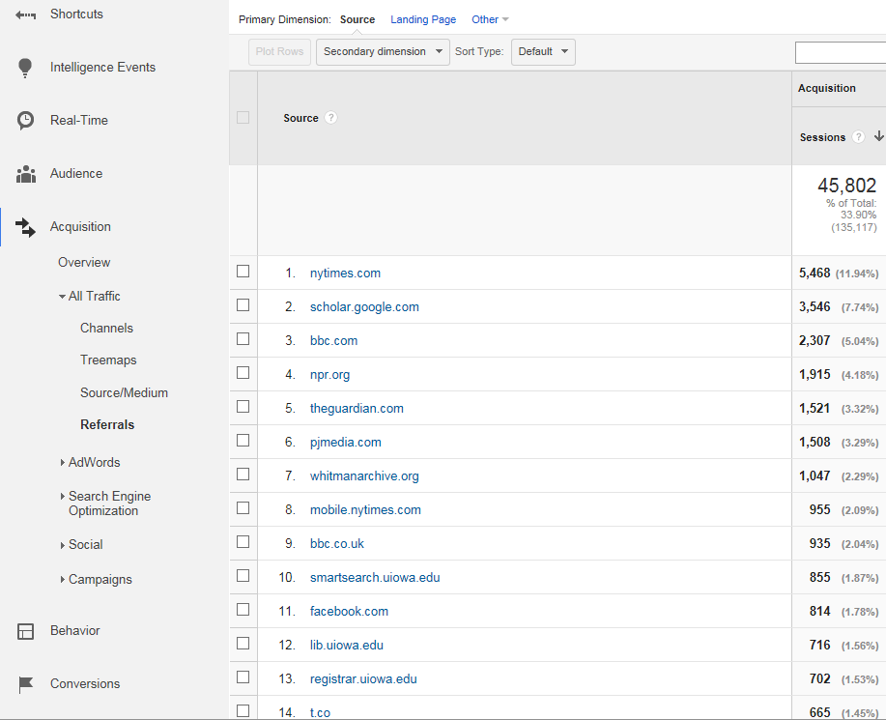
Google Analytics – Referrals, 1 Jan 2016-12 May 2016 Link resolvers will appear here
Google Analytics – Channels, 1 Jan 2016-12 May 2016 Numbers reflect our entire IR and do not include only journals. Spike on April 30 shown below.

Slide 12
Link Resolver Use
Filter on Source | Total Sessiona
serialssolutions | 590
SFX [note customers may not use this in URL] | 509
linksource.ebsco | 12
Counts from Google Analytics, 1 Jan–12 May 2016

Slide 13
Library Use
Filter on Source | Total Session
exlibrisgroup (excluding SFX) | 1638
primo (not in above) | 271
ebscohost | 320
worldcat | 47
firstsearch | 19
galegroup | 11
proquest | 7
proxy (not in above) | 250
Counts from Google Analytics, 1 Jan–12 May 2016

Slide 14
Importance of Discovery Systems
Worldcat — https://www.oclc.org/digital-gateway.en.html
ExLibris — http://www.exlibrisgroup.com/files/Products/Primo/InstitutionalRepositorySubmissionRequirements.pdf
SHARE — https://osf.io/share/registration/

Slide 15
Link Resolver 201
Have sympathy for your electronic resources librarian

Slide 16
KBART (Knowledge Bases And Related Tools)
NISO RP-9-2010 http://www.niso.org/publications/rp/RP-2010-09.pdf
NISO RP-9-2014 – Phase 2 – http://www.niso.org/apps/group_public/download.php/12720/rp-9-2014_KBART.pdf
Includes new fields for book and conference proceedings
Added “access type” field to identify completely free content and purchased/licensed content (including hybrid)
Added field to connect previous journal titles

Slide 17
KBART data fields “not every field … will be relevant to all content providers. However, all fields should be considered to be mandatory if they exist and all effort should be made to gather the data, even if it must be obtained from another area of the business or an external source.” p.3
publication_title
print_identifier
online_identifier
date_first_issue_online
num_first_vol_online
num_first_issue_online
date_last_issue_online
num_last_vol_online
num_last_issue_online
title_url
first_author
title_id
embargo_info
coverage_depth
notes
publisher_name
publication_type
date_monograph_published_print
date_monograph_published_online
monograph_volume
monograph_edition
first_editor
parent_publication_id
preceding_publication_title_id
access_type

Slide 18
From IRO-UIowa_Global_AllTitles_current available http://www.lib.uiowa.edu/studio/colophon/#kbart

Slide 19
Community Knowledge bases
Knowledge Base + (KB+)
https://www.kbplus.ac.uk/kbplus/
Service from JISC for UK libraries
Global Open Knowledgebase (GOKb)
http://gokb.org/
Began at NCSU to work with Kuali OLE
Open data, licensed CC0
Community includes multiple libraries in multiple countries

Slide 20
GOKb Community
Collaborating institutions:
Uploading and verifying publisher lists
My little bit:
Coding titles as open access or not
Making sure title changes reflected correctly in data
Recommended Practices for the Presentation and Identification of E-Journals (PIE-J) NISO RP-16-2013

Slide 21
Submitting to GOKb
Create a KBART file
Contact the GOKb editor (http://gokb.org/about-gokb/)
The editor will add your file

Slide 22
Let GOKb make the KBART file
The beauty of this model is that, once their data is properly formatted and stored in the GOKb, publishers can distribute this data to other knowledge base vendors, thereby pushing out high‐quality data across the supply chain.
— Kristen B. Wilson, "Bringing GOKb to Life: Data, Integrations, and Development" (2014).Proceedings of the Charleston Library Conference. http://dx.doi.org/10.5703/1288284315649

Slide 23
Open Journal Systems
GOKb pilot with a couple NC Universities to include OJS titles in GOKb (from their April 2016 news)
Stay tuned as this develops

Slide 24
But wait… there’s more…
Titles need to be activated in link resolvers

Slide 25
DOAJ & Selection
If your journal title is in DOAJ, it should be getting into link resolvers, and likely is active.
If your journal title is not in DOAJ, even if it is in a link resolver, it may not be activated.

Slide 26
Conclusion
Questions?

