Slide 1
ARL SPEC Kit:
Affordable Course Material and Open Educational Resources
A Lightening Round Talk
Library Publishing Forum - Denton, TX
May 17, 2016
Anita Walz, Open Education, Copyright & Scholarly Communication Librarian

Slide 2
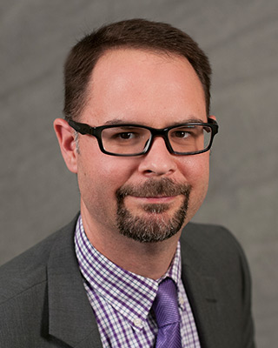
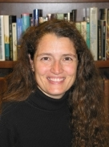
Fellow Co-Authors, Affordable Course Content & Open Educational Resources
Kristi Jensen
Program Development Lead,
eLearning Support Initiative
University of Minnesota Libraries
Dr. Joseph Salem, Jr.
Associate Dean for Learning, Undergraduate Services, and Commonwealth Campus Libraries
Penn State University Libraries

Slide 3
What’s ARL?
What’s a SPEC Kit?
What’s ACC? What’s OER?

Slide 4
ACC / OER
Affordable Course Content / Open Educational Resources

Slide 5
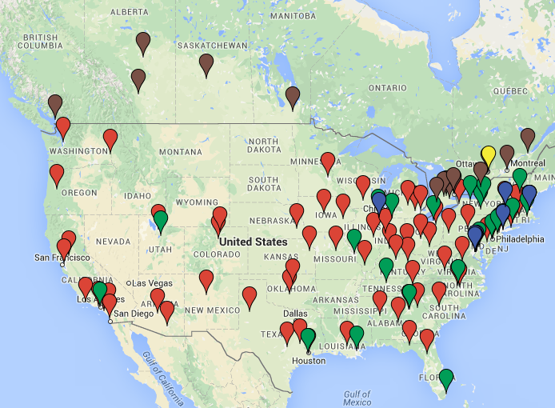
Institutions of the Association of Research Libraries
(ARL)
Source: https://www.google.com/maps/d/u/0/embed?mid=1ZlxvNJSbaAcpMpgPqlFwng05_nI

Slide 6
Survey Topics:
Institution-level initiatives
Open or Affordable or Both?
Originators & Implementers
Initiative governance
Incentives
Institutional policies & practices
Services provided
What have ACC/OER faculty adopted, adapted, created?
Assessment practices

Slide 7
Survey Topics:
Library roles & activities
Services
Faculty development topics
Staffing (who and from where?)
Knowledge & skills

Slide 8
Survey Topics:
Future library roles
Affordable Course Content
Open Educational Resources

Slide 9
Dates
July 5, 2016 Report published + free executive summary
http://publications.arl.org/SPEC_Kits
August 17, 2016 (1-1:45pm) Live Webinar
December 5, 2016 Embargo expires for no-cost full text display via institutional repositories

