Slide 1
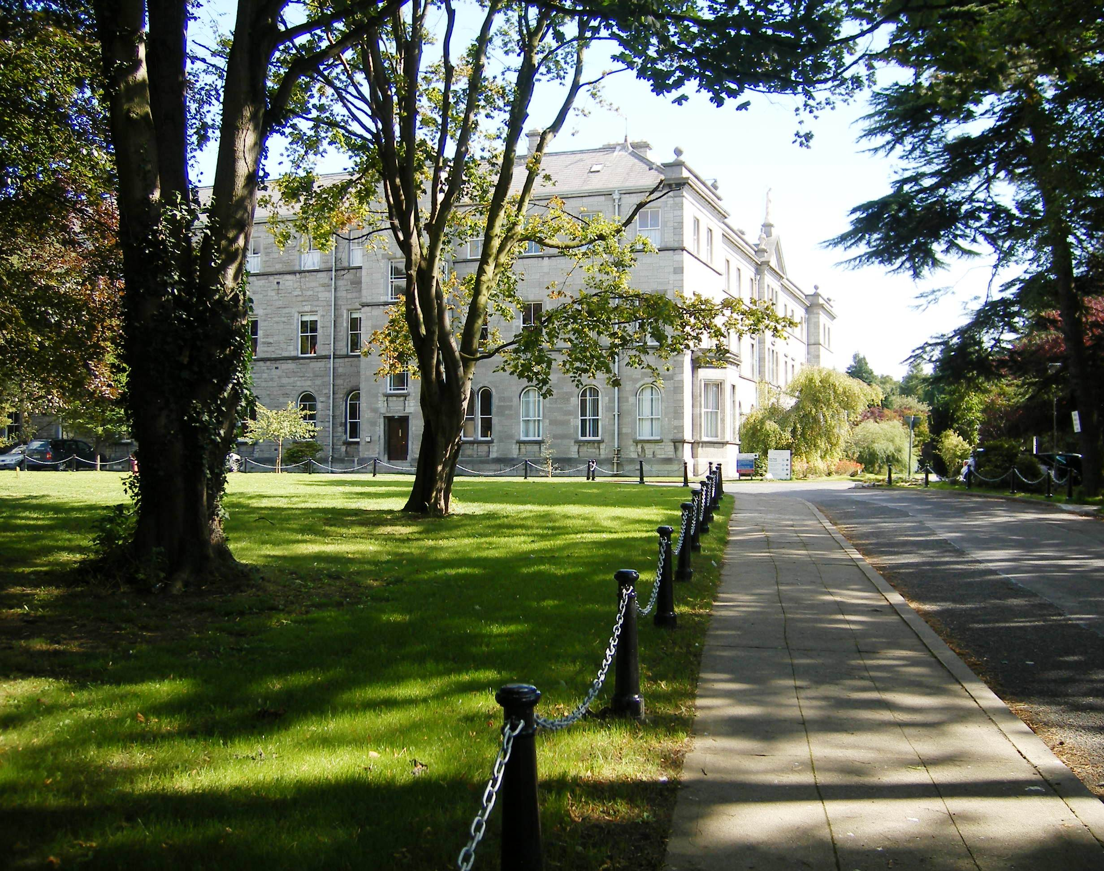
The potential of Library Publishing Services to transform scholarly communication in Ireland
Dr Johannah Duffy
Head of Library Services, Marino Institute of Education

Slide 2
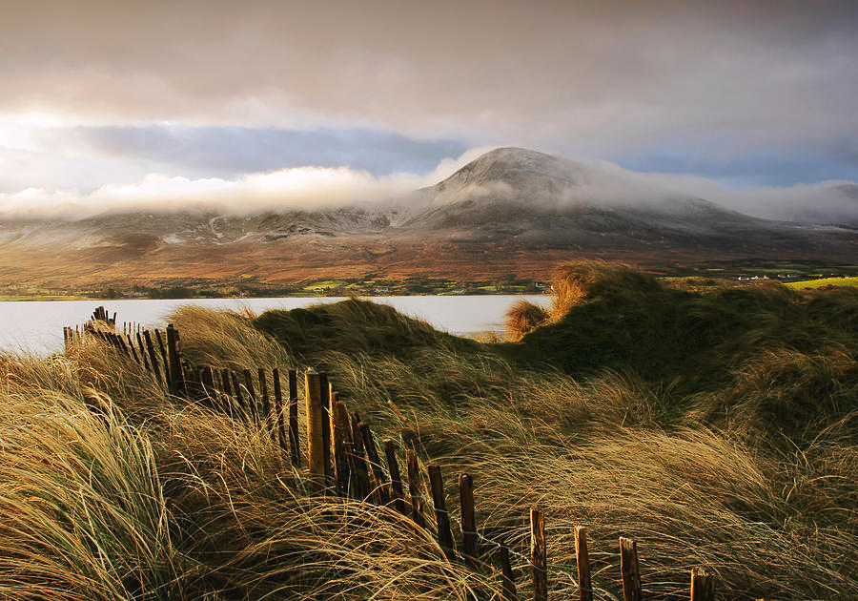
The Irish Landscape

Slide 3
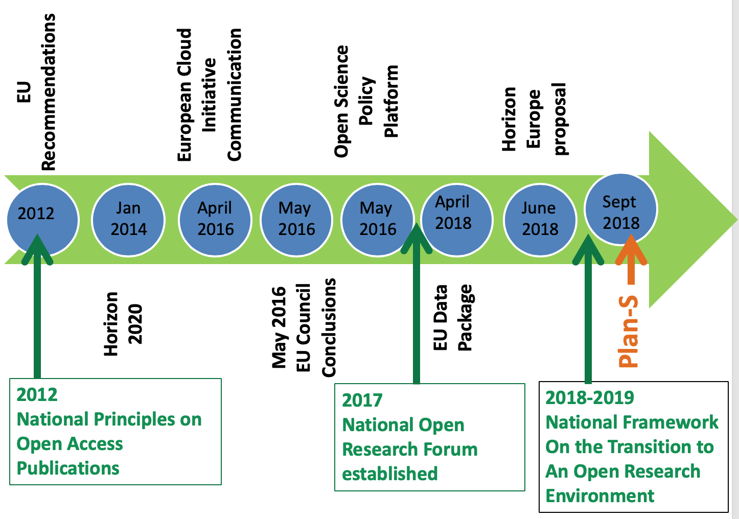
Irish Open Access Policy Timeline
National Open Research Forum 2
(NORF 2) 2020 –
2007
EURAB Recommend-ations
to European Commission [Irish Chair]
EC Recommenda-tions on Open Science, 25th April, 2018
Sept 2021
To date
2008 –
OA mandates:
all Irish funders; many institutions
Source Niamh Brennan, TCD, adopted from slide by Dr Patricia Clarke, HRB & NORF Co-chair

Slide 4
Ireland’s Open Access Repository Network
Research@THEA: Joint repository for all Institutes of Technology
Harvested
HSE Lenus
DKIT
Harvested
DBS
DCU
RCSI
NUI G
TCD
Greater discoverability
Higher impact
All research outputs
Marine I
TU Dublin
NUI M
UCD
Teagasc
HRB Open Research
UL
WIT
MI
UCC
Searched
Ireland’s OA Repository network: 26+ institutions
Includes all higher education institutions, research institutes and some public sector agencies (e.g. HSE’s Lenus)
National Open Access Portal: RIAN (http://rian.ie ) – RIAN: Higher Education Authority- funded
Funder-supported OA publishing platform: HRB Open Research
Source: Niamh Brennan, TCD

Slide 5
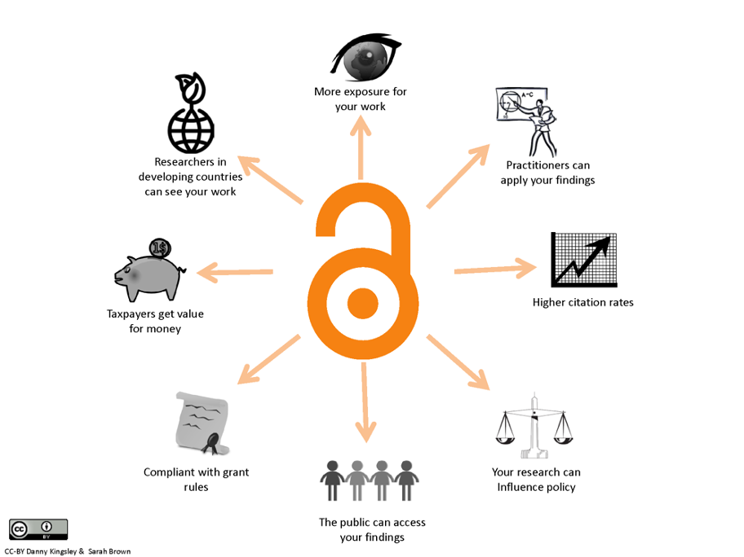

Slide 6
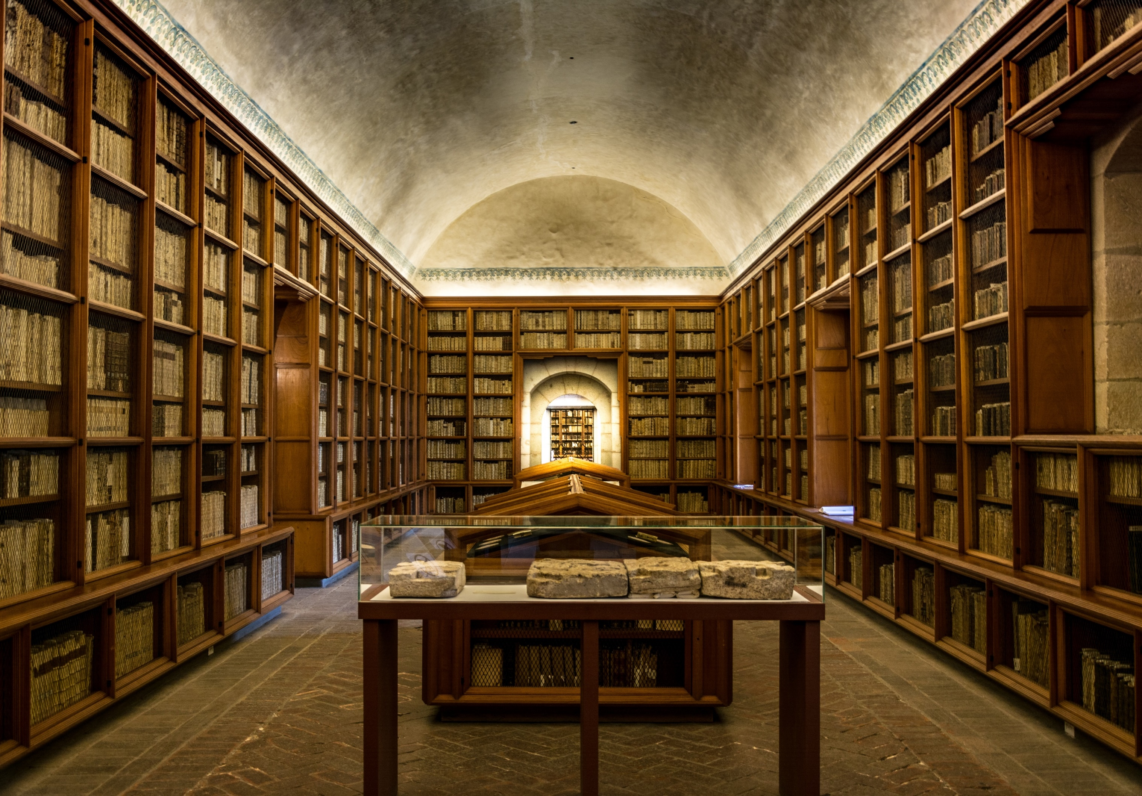
Library Publishing Journey

Slide 7
Biodiversity

Slide 8
Library Publishing Group Library Association of Ireland
https://www.libraryassociation.ie/library-publishing-group/
@LAI_LPG

Slide 9
Library Publishing Group Membership

Slide 10
Member Journals: Examples
https://arrow.tudublin.ie/jouarrow/
https://libguides.dbs.ie/dbslibrarypress

Slide 12
Thank you!
Email johannah.duffy@mie.ie
Tweet @maybe1177

