Slide 1
The Contract as Compliance: Negotiating Privacy and Accessibility in Library Publishing
Library Publishing Forum 2026
Ellen Dubinsky
Scholarly Communication Librarian,University of Arizona
Michele Gibney
Visiting Program Officer, SPARC
Head of Publishing and Scholarship Support, University of the Pacific
Notes:
ED:
Ask how many use DC or other commercial publishing platform
Ask how many use open-source locally hosted platforms or vended open-source hosted platforms
Ask if any of the attendees have a role in library vendor negotiations or licensing or know any of the specific terms in their publishing agreement

Slide 2
Title II
Purpose
Affected
Response
Deadlines
Accessibility Concerns
New Title II Requirements – effective 4/24/2026 4/26/2027
Section 504 Requirements (HHS) – effective 5/11/2026 5/11/2027
Ensure that web content and mobile applications are accessible to people with disabilities.
Applies to state and local government agencies & institutions (to start)
Institutional response and preparation varies widely based upon interpretation of the new requirements (and the exceptions)
Notes:
ED:
A little background – the confluence of factors that led Ellen & Michele to devote time to this work:
The new DOJ Title II requirements actually set a standard -- compliance to WCAG 2.1 AA standards – that public agencies had to meet. Note that these standards apply to web content, not PDFs. PDFs should comply with PDF/UA standards.
I would describe the outreach and number of webinars about accessibility that started popping up about 20 months ago welcome, but somewhat overwhelming, There was a lot of information shared, resulting in better understanding, sense of community, and some amount of panic.
Responses and preparation in advance of this rule going into effect varied widely across state government agencies. Your campus may have proactively tried to remediate content in advance of April 2027. Your campus may have focused solely on course and instructional content. Your campus may consider anything posted prior to 4/26/2027 can be considered “archives” and thus not covered. Your OGC may think there is little risk for your institution to be cited or sued by the federal government.

Slide 3
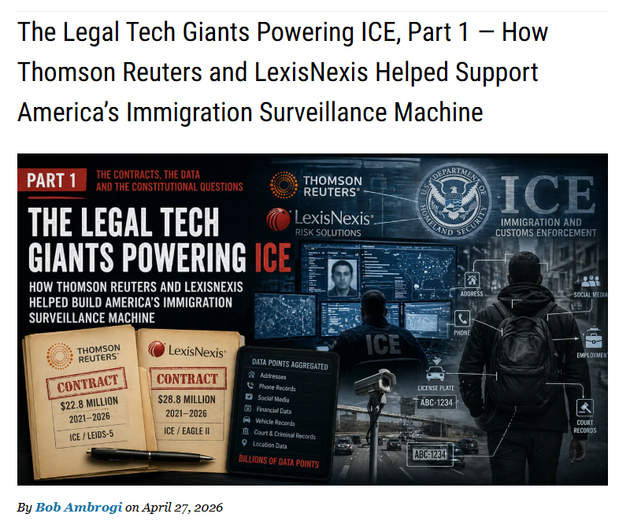
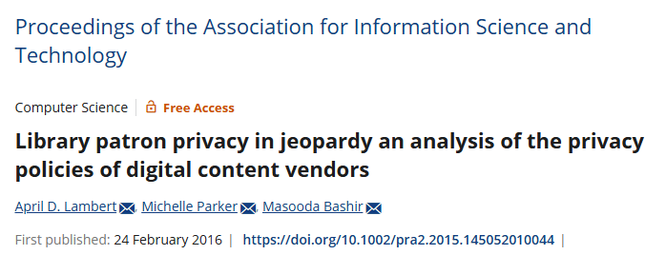


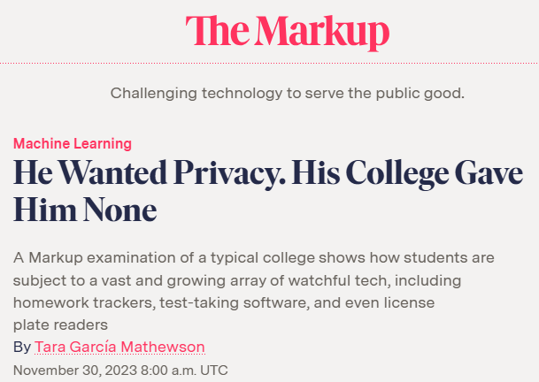
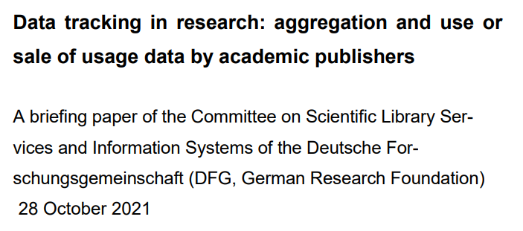
User Privacy and Surveillance Concerns
Notes:
ED:
Growing awareness since about 2020 of the threats to user privacy & surveillance, especially from library vendors that are parts of larger corporations that also have data broker businesses or divisions. Libraries are not the only entities that are realizing that Elsevier (part of RELX) and Thomson-Reuters (LexisNexis) are selling user data not only to marketing businesses but also selling that data to local governments, police departments, Homeland Security, etc. for purposes not related to teaching and learning.
The fact that major library publishers are closely associated with data brokering is really problematic – RELX and TR provide databases that law school libraries must license access to – there aren’t viable alternatives to LexisNexis and Westlaw.
There are concerns about data privacy for textbook publishers, learning management systems, proctored online testing platforms as well – and this isn’t only a concern for higher education. These platforms are used in K-12 settings. Legitimate concerns that PII data is being collected about individual students throughout their educational journey and then into the workplace through use of HR and employment platforms owned by those same corporations.

Slide 4

The Why
Growing awareness of threats to user privacy and surveillance in library contexts
Collaborate with SPARC as leading members of the Privacy & Surveillance Contracts Working Group
Act as content stewards and managers of our library’s publishing programs
Acknowledgement of the importance of the Triangle Research Libraries’ Network’s Accessibility Negotiation Guide
Notes:
ED:
Work of Sarah Lamdan, Becky Yoose, and SPARC to increase awareness of threats facilitated by library vendors
Our work with SPARC and the P&S Contracts WG
Learning about how library agreements contribute to the threat (with the inclusion of terms) that don’t reflect “library” values
Realizing the the TRLN Accessibility Guide (2022) was a great way to share knowledge and strategies, and empower libraries with ways to address our values and needs, act in the interest of our users
Desire to empower other libraries to fight the good fight

Slide 5




Use close reading and editing of vendor licensing agreements to ensure equity in access and protecting users’ privacy.
Work with your acquisitions/collections colleagues to look for harmful terms and share strategies for mitigating the potential for harm.
Educate users about what identifying data may be collected when they use vendor products/platforms
Educate users about how they can limit this data collection
  When there is an option to change cookie settings, take advantage of the opportunity!
Consider including data privacy knowledge, skills, and abilities in new hire job descriptions and rewriting current job descriptions to include this language.
Libraries Are Not Powerless!
Notes:
ED:
Access to resources, freedom of inquiry, and user privacy are key “library” values. And this is not a “doom and gloom” presentation. We can work to raise awareness of privacy threats in our libraries and actively cultivate communities of practice that prioritize privacy. As individuals, we may not serve in library roles that directly affect the effects of vendor behavior, but we can spread the word and help spark change. We can develop more robust policies and procedures in our libraries to prioritize accessibility and data privacy for all.
Can use close reading and editing of vendor licensing agreements to ensure we are ensuring equity in access and protecting our users’ privacy.
In your role as “library publisher,” you may not directly be involved in licensing, but you can work with your acquisitions/collections colleagues to look for harmful terms and share strategies for mitigating the potential for harm.
Negotiate strong privacy requirements in licensing agreements, such as data processing agreements or addenda, to address and limit what data the vendors we subscribe to can collect about our patrons and how such data can be used.
Require privacy reviews before committing to purchasing a resource, checking if the vendor has a privacy policy that provides meaningful protections and if the resource addresses minimum technical privacy requirements.
Reconsider purchasing decisions with vendors that do not take sufficient steps to protect user privacy and promote accessibility, potentially moving some products to competitors with superior privacy practices or using cancellations as a negotiation strategy.
Educate ourselves and our patrons about what identifying data may be collected about patrons while they use vendor products.
Educate ourselves and our patrons about how patrons may be able to limit this data collection (e.g., by not creating personal accounts or not logging in when not necessary).
When there is an option to change cookie settings, take advantage of the opportunity!
Consider including data privacy knowledge, skills, and abilities in new hire job descriptions and rewriting current job descriptions to include this language.

Slide 6
Triangle Research Library Network: Guide to Negotiating Accessibility in E-Resource Licenses
ONEAL Privacy & Surveillance Module
SPARC Data Processing Addendum
Upcoming SPARC Privacy Negotiation Guide (target pub. date: 12/2026)
SPARC Contract Library
CDL Redacted License Agreements
ESAC Registry of Open Publishing Agreements
Resources Related to Contracting:
Notes:
ED:
These resources help us help our users

Slide 7
Let’s Look At Some Language!
Notes:
Michele

Slide 8
Refers to specific standards or requirements
  e.g. WCAG 2.1 or 2.2, Level AA minimum, apply to all user-facing AND admin interfaces
Proof of vendor compliance with existing standards and across updates, patches, and new features
  e.g., Voluntary Product Accessibility Template (VPAT)
Licensee right to test/verify for accessibility
  e.g. conduct audits, user third-party testers, require user testing if needed
Vendor will remedy identified accessibility complaints
  e.g. Define timelines by severity:
    Critical (blocking): remedy 5-15 days
    High: e.g., 30 days
    Moderate: e.g., 60-90 days)
Accessibility: Language to Look For
Notes:
Michele
Talking points
Reference to specific standards or requirements (e.g. WCAG 2.1 or 2.2, Level AA minimum, apply to all user-facing AND admin interfaces)
Ex. Vendor warrants that the Product conforms to WCAG 2.1 Level AA (or most current version required under ADA Title II) for all public and staff-facing functionality.
Proof of vendor compliance with existing standards (e.g., VPAT) and across updates, patches, and new features
Ex. Accessibility conformance shall be maintained throughout the term of the agreement, including all updates, upgrades, and new releases.
Ex. Vendor shall provide an updated VPAT upon request and disclose known accessibility issues and planned remediation.
Right to test/verify for accessibility (e.g. conduct audits, user third-party testers, require user testing if needed)
Ex. Institution reserves the right to perform accessibility testing or engage third-party evaluators, and Vendor agrees to cooperate and provide necessary access.
Vendor will remedy identified accessibility complaints (e.g. Define timelines by severity: Critical (blocking): e.g., 5-15 days; High: e.g., 30 days; Moderate: e.g., 60-90 days)
Ex. Vendor shall remediate confirmed accessibility defects within defined timeframes based on severity, not to exceed 30 days for critical issues that block access.

Slide 9
No additional costs for remediation
Accessibility roadmap / product evolution
User support and accommodation pathway
Responsibility split
Indemnification / risk allocation (protects your institution!)
Termination or penalty clause
Accessibility: Language to Look For
Notes:
Michele
Talking points
No additional costs for remediation
Ex. Accessibility remediation shall be provided at no additional cost to the Institution.
Accessibility roadmap / product evolution
e.g. Commitment to ongoing improvement; Alignment with evolving standards like WCAG updates
Ex. Vendor agrees to maintain an accessibility roadmap aligned with evolving WCAG standards and applicable regulations.
User support and accommodation pathway
e.g. accessible support channels; clear escalation path for accessibility complaints)
Ex. Vendor shall provide an accessible mechanism for users to report accessibility barriers and ensure timely response and resolution.
Responsibility split
e.g. who is responsible for templates and who for uploaded content
Ex. Vendor is responsible for accessibility of system interfaces and templates; Institution is responsible for content it uploads, except where tools limit accessibility.
Indemnification / risk allocation (protects your institution!)
Ex. Vendor shall indemnify Institution against claims arising from failure to meet stated accessibility requirements.
Termination or penalty clause
Without enforceability, clauses are weak. Look for right to terminate for sustained non-compliance, or service credits / penalties)
Ex. Failure to cure material accessibility defects within 90 days shall constitute grounds for immediate termination of the contract without penalty to the Institution.

Slide 10
Licensor shall use commercially reasonable efforts to provide an accessible web presence in accordance with the Licensor’s Accessibility Statement [LINK], which may be amended from time to time. Licensor will make reasonable efforts to promptly respond to and resolve any complaint regarding accessibility of the Licensed Products. Licensor shall provide to Licensee, upon request, a current, accurate, completed Vendor Product Accessibility Template (VPAT) to demonstrate compliance with accessibility standards.
Accessibility Language: Before
Notes:
Michele
The language does ask for compliance verification via the VPAT
However, no specifics. Doesn’t indicate what we need to aim at in terms of accessibility
Links out to an Accessibility Statement, not in the contract terms,

Slide 11
Licensor shall comply with the Americans with Disabilities Act (ADA), by supporting assistive software or devices such as large print interfaces, text-to-speech output, voice-activated input, refreshable braille displays, and alternate keyboard or pointer interfaces, in a manner consistent with the Web Accessibility Initiative Web Content Accessibility Guidelines 2.1 AA (http://www.w3.org/WAI/guid-tech.html). Licensor shall ensure that product maintenance and upgrades are implemented in a manner that does not compromise product accessibility. Licensor shall provide to Licensee a current, accurate completed Voluntary Product Accessibility Template (VPAT) to demonstrate compliance with accessibility standards (https://www.itic.org/policy/accessibility).
Accessibility Language: After
Notes:
Michele
Calls out specific ruling/legislation requirements that must be met
Lists examples of accessibility-enhancing features
Asks for compliance verification via the VPAT

Slide 12
How data will be used
Data privacy and security
Confidentiality
References to data protection laws
External privacy policies and EULAs
Data processing
Data Privacy: Language to Look For
Notes:
Michele
Talking points
Confidentiality
No selling or sharing of user data
Want to make sure user data and activity on vendor’s platform remains confidential – not shared or sold to any other entity
Limitations on what data can be collected
How data will be used and by whom. Limit uses to just what improves the product or service, or allows usage reporting
External terms or end-user licenses. Links to website privacy policies or requirements for users to create individual accounts to “enhance” use of the product/platform
How data will be processed, retained
Compliance with applicable laws
Language about FERPA, GDPR, or relevant state data privacy laws
Reference to specific laws
Ensure data is anonymized, aggregated, de-identified. Restrictions on what can be done with raw data
Limitations on data retention
Clarification of who owns the user data?
Confidentiality and non-disclosure of user data e.g., Maintain confidentiality of user activity; prohibit selling or sharing data with third parties.
Restrictions on data collection and use e.g., Limit data use solely to performance of the licensed service; restrict collection to strictly necessary data.
Data aggregation and anonymization requirements e.g., Require usage data to be anonymized and aggregated for reporting; raw usage data must not be provided to third parties.
Commitment to specific laws and regulations e.g., Vendor will comply with applicable laws (e.g., GDPR, FERPA) and institutional policies.
Institutional terms take precedence e.g., Contract language overrides linked-out terms, End User License Agreements (EULAs), or online privacy policies.
Requirements for data retention and deletion e.g., Data must be deleted upon termination of the agreement; privacy clauses must survive the term of the license.

Slide 13
In order to fulfill its obligations under this Agreement for legal and administrative purposes, Licensor shall be entitled to:
Hold and process the Licensee’s personal data as defined in applicable privacy and data protection legislation;
Make such information available to i) business partners, sub-contractors, and/or suppliers who provide products or services to Licensor.
This clause shall survive termination of this agreement.
Data Privacy Language: Before
Notes:
Michele
Lacks details about which “applicable privacy and data protection: legislation
Clause doesn’t expire at the end of the term of agreement – this means the Licensor is retaining and sharing the data (and possibly using the user data) forever

Slide 14
The Licensor agrees that no personally identifiable information, including but not limited to log-ins recorded in system logs, IP addresses of patrons accessing the system, saved searches, usernames and passwords, will be shared with third parties, except in response to a subpoena, court order, or other legal requirement.
Licensor agrees that all data, information, or content created, generated, provided, or stored in the product or service by Licensee or its Authorized Users will be used only in conjunction with the product or service being provided, that it will not be used for any other purpose, or be released by Licensor or copied in any manner for any other use and will be promptly returned or destroyed upon termination of this Agreement.
This clause shall survive termination of this agreement for a period not to exceed two years after Licensee has ceased all access to the licensed material.
Data Privacy Language: After
Notes:
Michele
Provides examples of the PII that might be collected (but not an exhaustive list; uses the term “including but not limited to”)
Does explain what the only exception to sharing any personal information is (the carve out for legal reasons)
Limits how the personal data can be used – only for making the product work or improved (“used only in conjunction with the product or service being provided”)
Specifies that data will be returned or destroyed upon termination of the agreement
Specifies how long after termination of the agreement this clause stays in effect (specifying a limit to the length of time specific clauses of an agreement last is a good practice – also used in relation to how long confidentiality lasts in terms of agreement pricing)

Slide 15
Licensor shall make commercially reasonable efforts to ensure that the Licensed Materials are compliant with Section 508 standards issued by the federal government (www.section508.gov/) and W3C.org Web Content Accessibility Guidelines (WCAG 2.1 Level AA) (www.w3.org/TR/WCAG21/) for accessibility for persons with disabilities for the minimum level of accessibility.
How Would You Improve This Accessibility Language?
Notes:
ED:
Now it’s your turn to suggest improvements ..
Could also mention:
Availability of a VPAT
Compliance with all applicable federal/state laws and regulations, such as
Americans with Disabilities Act (ADA)
Title II
Language about remediating for non-compliance with a time-frame (even “in a timely manner” is better than nothing)

Slide 16
To the extent that [VENDOR] processes personal data (as that term is defined under applicable law) pursuant to this Agreement it shall do so in accordance with its Privacy Policy available at [URL]
How Would You Improve This Data Privacy Language?
Notes:
ED:
Data privacy language will probably be included in many parts of an agreement, rather than in one single section. The above just deals with the data processing.
Link out to online privacy policy is bad news.
Request that language of the current online privacy policy be added to this particular agreement as an appendix or addendum.
Request inclusion of a clause indicating that if external terms conflict with terms within the actual agreement itself, the terms of the agreement take precedence
Add language to the license, or in an addendum, that nullifies linked out terms or end user license agreements.
Ask to include language that the vendor must maintain the confidentiality of all user information and usage data and will not give or sell it to third parties.
Ask for better definition of “personal data” (though most contracts tend to use the terms “as that term is defined under applicable law”)
Most importantly, make sure other data privacy concerns are addressed in other parts of the agreement!

Slide 17
Privacy Policy
[VENDOR] may provide aggregated, anonymous statistical information about [PRODUCT] subscribers to other persons, including potential advertising clients. For detailed information, please click the [VENDOR] Privacy Policy link at the bottom of any screen of [VENDOR PRODUCT PLATFORM].
How Would You Improve This Data Privacy Language?
Notes:
ED:
Note: this is a real example!
How to improve:
Explicit statement that terms within this Agreement override any external terms, conditions
“External Terms are null and void and will have no effect under this Agreement, even if Licensee or its Authorized Users express assent or agreement to External Terms. External Terms include any shrinkwrap, clickwrap, browsewrap, web-based terms and conditions of use, and any other terms and conditions displayed in any format that Licensee or its Authorized Users are required to accept or agree to before or in the course of accessing or using any goods or services provided by Licensor.”
No selling or sharing of user data without Licensee’s written authorization
Disclosure of user data must be anonymized or aggregated
Explicitly state that includes protecting the confidentiality of searches
Vendor must comply with all applicable privacy laws and regulations. If you’re in a state with state privacy laws, cite those specifically
Language about data retention – how long can the data be retained by vendor
Ideally, data will be sent to Licensee and deleted by Vendor
Language about data belonging to the Licensee, not the Vendor.

Slide 18
Who negotiates licenses for your library?
Look at your library’s website. Does your library provide library policies regarding accessibility or privacy? Do those terms adequately address the concerns of your users?
Look at some of the online terms & conditions for one or two databases that your library licenses. What do you think of some of those terms?
Raise Awareness In Your Library
Notes:
ED:
Most of us don’t do the close reading of vendor licensing agreements, but we can reach out to our colleagues and make new connections within our libraries! We can nudge our colleagues to become more aware of the need for us to be more proactive in asking (and getting) what we want (or closer to what we want) when negotiating. We can provide more information about accessibility and user privacy to our patrons. We can monitor what our vendors are doing.
And Michele is going to share a bit more about how to do that.

Slide 19
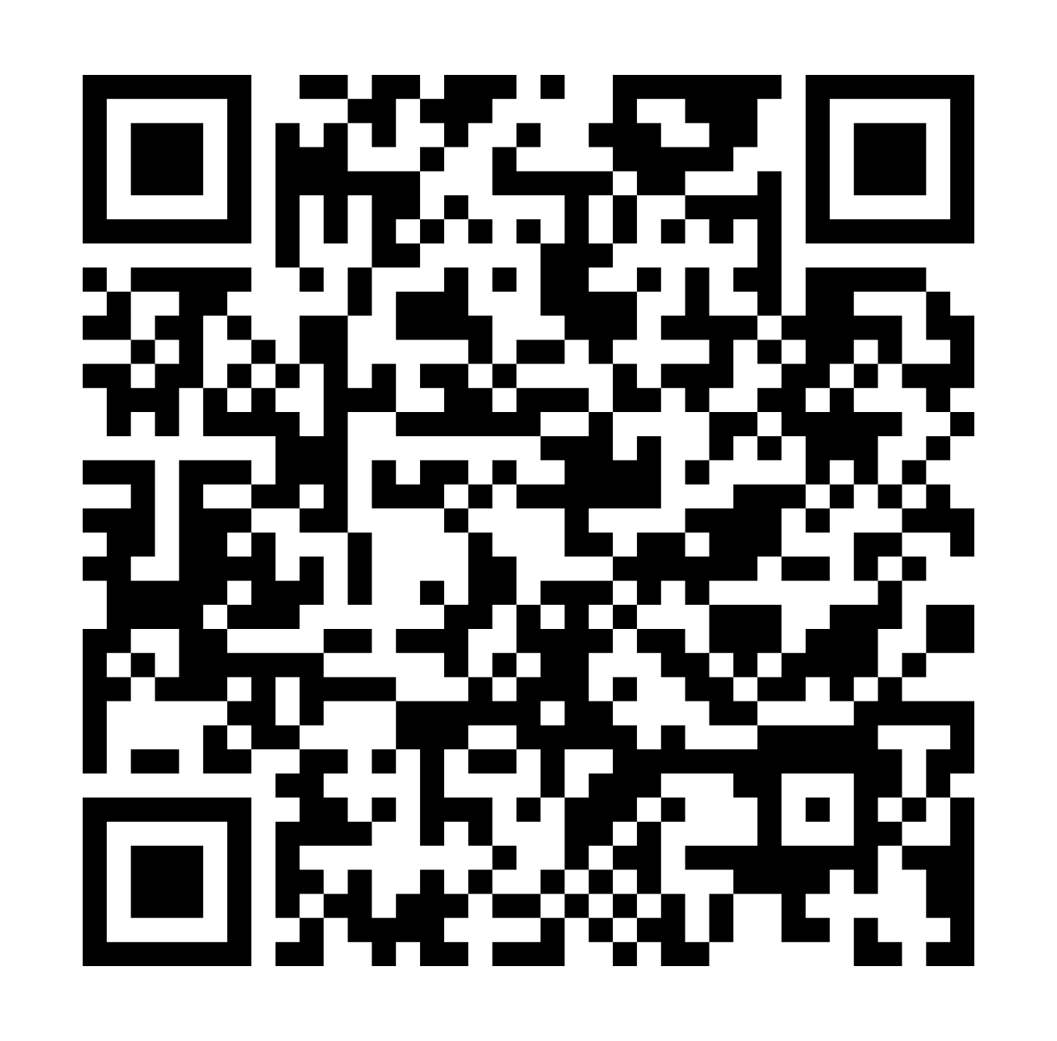
Language
Resources
Audit
Next Steps
Notes:
Michele

Slide 20
Identify Your Publishing Platforms
Identify Ownership & Responsibility
Identify Community Members You May Need
Publishing Stack Audit #1 Goal: Map your publishing ecosystem, identify who controls contracts, and assess policy gaps.
List all platforms used for publishing or hosting content (journals, repositories, books, exhibits, etc.).
Prompt:
Are you using multiple systems (e.g., OJS + Digital Commons + Omeka)?
Are any platforms “informal” or locally built (e.g., WordPress sites, faculty-led journals)?
For each platform above, identify who controls it—technically and contractually.
Prompt:
Is the library actually the contract holder?
Is it procurement, IT, consortia, or central administration?
Do you know the individual role (e.g., Dean, CIO, contracts officer)?
List key people you would need to involve if you wanted to change contract language.
Notes:
Michele
5 minutes
https://docs.google.com/document/d/1kct55kbyxK7Frahv5W2Jip6WPuc5PaTpQ_u6gqJBxHA/edit?usp=sharing

Slide 21
Which Platforms Are Under Contract?
Key Questions
Risk Scan (Quick Assessment)
Publishing Stack Audit #2 Goal: Identify Contracts That Affect Your Publishing Program
Focus especially on vendor-hosted systems.
Check all that apply:
☐ Do you use a vended publishing platform (e.g., Digital Commons, OJS hosting provider, Janeway hosting)?
☐ Are contracts negotiated outside the library?
☐ Are accessibility or privacy terms standard boilerplate (not negotiated)?
☐ Do you have access to the full contract text?
For each platform, note potential concerns on your worksheet.
Notes:
Michele
Shorter and easier now that previous slide is done - 2 minutes

Slide 22
Locate Statements
Evaluate Quality
Identify Gaps & Opportunities
Publishing Stack Audit #3 Goal: Review Platform Policies (Accessibility + Privacy)
For each platform, check for public-facing statements.
1. Does the accessibility statement mention WCAG (2.1 or 2.2, Level AA)?
2. Does it describe how users report problems?
3. Is the privacy statement clear about data collection, tracking, and third parties?
1. What’s missing or weak?
2. What could be improved in accessibility? (e.g., clearer compliance statement, reporting pathway, timelines)
3. What could be improved in privacy? (e.g., tracking disclosure, user rights, data retention)
Notes:
Michele
10 minutes?/depending on time
Break group up into smaller groups based on the platform they’re going to investigate - (determine the most common platforms from the previous slide and then say, if you’re doing this one, partner with 1-3 other people doing the same one and answer these together)

Slide 23
Final Thoughts
Wrap-Up
Prompt #1
– Which Platforms Will You Prioritize?.
– What Contracts Will You Review?
– Who Will You Meet With?
What surprised you about who actually controls contracts?
Prompt #2
Prompt #3
Where does the library have leverage vs. not?
Which issue feels most urgent: accessibility, privacy, or governance?
Notes:
Michele
5 minutes or however much time we have left.

Slide 24


Thank you!
Library Publishing Forum 2026
Ellen Dubinsky, edubinsky@arizona.edu
Michele Gibney, mgibney@pacific.edu
Notes:
Michele

Slide 25
Resources
DOJ Rule: Nondiscrimination on the Basis of Disability; Accessibility of Web Information and Services of State and Local Government Entities
ARL: ADA Title II regulations: implications for libraries
Triangle Research Library Network: Guide to Negotiating Accessibility in E-Resource Licenses
SPARC’s Navigating Risk in Vendor Data Privacy Practices: An Analysis of Elsevier’s ScienceDirect
SPARC’s Navigating Risk in Vendor Data Privacy Practices: An Analysis of Springer Nature’s SpringerLink
Notes:
Michele

